Slide 1

Massive MIMO Channel Estimation Based on Block Iterative Support Detection
Wenqian Shen¹, Linglong Dai¹, Yi Shi², Zhen Gao¹, and Zhaocheng Wang¹
¹Tsinghua University, Beijing, China
²Huawei Technologies, Beijing, China
Notes:
Good morning, ladies and gentlemen, I am glad to take part in WCNC 2016. My paper titled “Massive MIMO Channel Estimation Based on Block Iterative Support Detection” is a joint work of Dai Linglong， Gao Zhen and Wang Zhaocheng from Tsinghua University, Beijing, China. And Shi Yi from Huawei technologies.
Since the pilot overhead for massive MIMO channel estimation becomes overwhelming, we propose the block iterative support detection algorithm to achieve pilot overhead reduction.

Slide 2
Contents
1
Technical Background
2
Proposed Solution
3
Performance Analysis
4
Simulation Results
5
Conclusions
Notes:
The presentation is divided into five parts. First of all, we will make a brief review of the technical background to see what problems we have. To solve those problems, our proposal is presented in section 2, then we provide some performance analysis in section 3. Simulation results are provided in Section 4 to investigate the performance of the proposed scheme, and the final conclusions are drawn in Section 5.

Slide 3
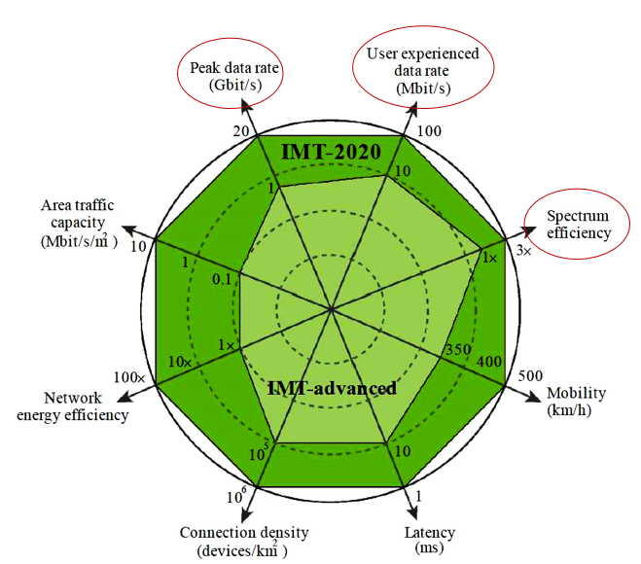
Key Performance Indicator (KPI) of 5G
ITU Sep. 2015
Notes:
5G has becomes a hot topic recently. International telecommunication union recommend that from IMT-Advanced to IMT-2020, the spectrum efficiency, user experienced data rate and peak data rate should be increased by 3 times, 10 times and 20 times, respectively.

Slide 4
How to Realize 5G?
One consensus：Improve the system capacity 1000x in ten years
Notes:
There is a consensus about 5G that the system capacity should be increased by 1000times in ten years. There are three ways to achieve this objective. The first way is based on spectrum extension, the second way is to increase the network density. The third way is to increase the spectrum efficiency, where massive MIMO can play an important role.

Slide 5
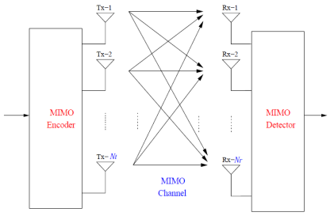
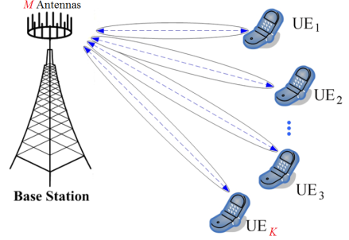

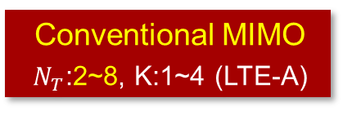
What is Massive MIMO?
Use hundreds of base station (BS) antennas to simultaneously serve multiple users
Conventional MIMO
$N_{T}$:2~8, K:1~4 (LTE-A)
Massive MIMO
$N_{T}$: ~100~1000, K: 16~64
[1] T. L. Marzetta, “Non-cooperative Cellular Wireless with Unlimited Numbers of Base Station Antennas,” IEEE
Transactions on Wireless Communications, vol. 9, no. 11, pp. 3590-3599, Nov. 2010. (2013 IEEE Marconi prize)
Notes:
So, what is massive MIMO? Different from traditional MIMO, massive MIMO use hundred of base station antennas to simultaneously serve multiple users.

Slide 6

Overwhelming Pilot Overhead
Channel state information (CSI) is essential for precoding and power allocation
Orthogonal pilots for LTE/LTE-A
100% pilot !
The number of orthogonal pilots is linearly increased with the number of BS antennas
Notes:
As we know, channel state information (CSI for short) is essential for channel adaptive techniques such as precoding and power allocation.
In LTE and LTE-Advanced, orthogonal pilots is used for channel estimation. Different channels are distinguished by orthogonal pilots. Thus, the number of pilots is linearly increased with the number of BS antennas. With the greatly increased number of BS antennas in massive MIMO system, pilot will occupy all the time-frequency resource.

Slide 7
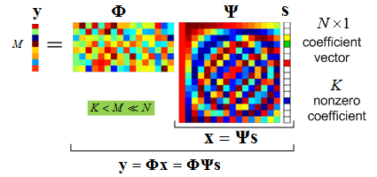
CS-Based Channel Estimation
Compressive Sensing (CS)
  Reconstruct a sparse signal by a sampling rate much lower than the Nyquist rate
Sparsity in channel impulse response (CIR)
  The number of significant paths in CIR is limited
Conventional CS-based channel estimation schemes
usually assume prior knowledge of channel sparsity level
Notes:
Compressive sensing provide a promising way to reduce pilot overhead by taking channel sparsity into account.
As shown in the left figure, compressive sensing (CS for short) is a new signal processing theory that can recover high-dimensional sparse signals s from low-dimensional measurements y with an overwhelming probability.
On the other hand, As shown in the right figure, the channel impulse response (CIR for short) is sparse due to the limited number of significant paths.
However, conventional CS-based channel estimation schemes usually assume prior knowledge of the channel sparsity level.

Slide 8
Contents
1
Technical Background
2
Proposed Solution
3
Performance Analysis
4
Simulation Results
5
Conclusions
Notes:
In this paper, we propose the block iterative support detection based channel estimation scheme.

Slide 9
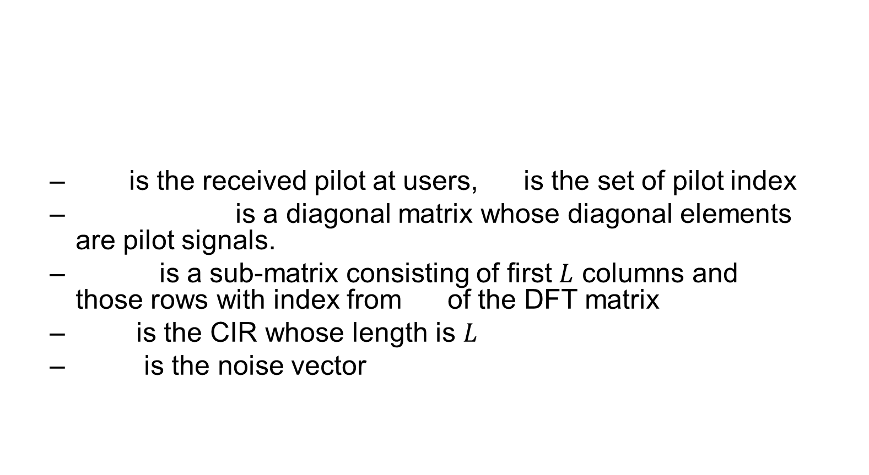
System Model
Rewrite as Matrix
Notes:
Let’s see the system model. y\omega is the received pilot at users, where \omega is the set of subcarrier index assigned to pilot. Ci is a diagonal matrix…FL is a sub matrix of the DFT matrix. hi is the CIR
FL times h ,we get a frequency-domain channel vector. Then ,it is multiplied by the frequency-domain pilots. n\omega is the noise vector.
Then, we rewrite the left equation as matrix multiplication like the right equation.
h is a larger vector consisting of NT CIRs associated with $N_{T}$ BS antennas.
Then, the channel estimation problem is transferred as an underdetermined problem. Where y\omega is the low-dimension measurements and h is the high-dimension sparse vector.

Slide 10
Block Sparsity
CIRs share a common support since different CIRs associated with different antennas have similar path arrival times
Notes:
Note that all the CIR share a common support since different CIRs associated with different antennas have similar path arrival times.
Thus, as shown in the Figure, we can group the elements of h_i with the same indexes into non-zero blocks and zero blocks to generate the block-sparse equivalent CIR g
Accordingly, the system model also changed as y\omega equals to \theta times g plus n\omega.

Slide 11
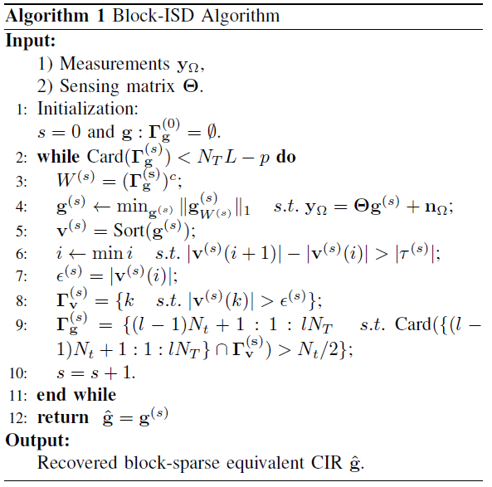
Block Iterative Support Detection
Our proposed Block-ISD algorithm
  Support detection is based on sparsity level-independent threshold, which is dependent on the `first significant jump' rule ^{[2]}
  Only if more than half of the elements in a block are non-zero elements, this block will updated as non-zero block
[2] Y. Wang and W. Yin, ``Sparse signal reconstruction via iterative support detection," SIAM Journal on Imaging
Sciences, vol. 49, no. 6, pp. 2543-2563, Jun. 2011.
Notes:
Then we propose the block iterative support detection algorithm to solve this underdetermined problem.
The support detection is based on the sparsity level-independent threshold in step 8. This threshold is dependent on the first significant jump rule.
Compared with the classical ISD algorithm, the key difference of block-ISD is the consideration of the block sparsity g in step 9.
For a certain non-zero block of g, continuous $N_t$ elements of this block are supposed to be non-zeros. However, the support detection of some elements may be incorrect due to the impact of noise. however, we can fix this support detection error. Only when more than half of elements in a block is detected as non-zeros, we will update this block as a non-zero block. This mechanism is expected to increase the robustness of the support detection and thus improve the channel estimation performance.
This will be verified by simulation results.

Slide 12
Contents
1
Technical Background
2
Proposed Solution
3
Performance Analysis
4
Simulation Results
5
Conclusions
Notes:
In this paper, we also provide performance analysis.

Slide 13
Maximal Mutual Coherence (MMC)
MMC is defined as the largest normalized absolute inner product between any two columns, i.e.,
The smaller MMC of the sensing matrix P ensures reliable channel estimation performance ^{[3]}
  is the recovered channel vector
  is the noise power
  is the sparsity level of channel vector
[3] M. Duarte and Y. Eldar, ``Structured compressed sensing: From theory to applications," IEEE Trans. Signal
Process., vol. 59, no. 9, pp. 4053-4085, Sep. 2011.
Notes:
Firstly, we introduce a classical indicator of sensing matrix P. The maximal mutual coherence, MMC for short. MMC is defined as the largest normalized absolute inner product between any two columns . In the first equation, Pi and Pj is the i-th and j-th column of P,. respectively.
As shown in the second equation, smaller MMC of the sensing matrix P ensures reliable channel estimation performance.

Slide 14
Maximal Mutual Coherence (MMC)
The MMC is dependent on the pilot sequence since
Unit-norm pilot pattern
  The elements of the pilot sequences Ci have independent random phases but a unit amplitude
Then, the MMC is expressed as
  where
  denotes the k-th element of
  is the set of subcarrier indexes assigned to pilots
Notes:
Since the sensing matrix P is generated as this equation. The MMC is dependent on the pilot sequence.
We propose the unit norm pilot pattern. The elements …
Then the MMC can be expressed as . Where i,j is larger than 1 smaller than

Slide 15
Expectation of MMC
(a) if and
  The expectation of is zero since
(b) if and
  The expectation of is zero since
(c) if and
  The expectation of is zero since
Notes:
Then, we considere three cases, for the first case, the MMC can be simplified as
Then expectation of MMC is zero, since mk over N follows the uniform distribution.
Theta I,k and theta jk are the phase of pilots element cik and cjk.
To sum up, the proposed pilot pattern results in a small MMC, which ensures reliable channel estimation performance.

Slide 16
Contents
1
Technical Background
2
Proposed Solution
3
Performance Analysis
4
Simulation Results
5
Conclusions
Notes:
Then, let’s see the simulation results.

Slide 17
Simulation Results
Parameters
  ITU Vehicular B channel model
  number of antennas
  system bandwidth
  OFDM symbol length
  maximal channel length
  number of pilots
50 MHz
Notes:
The simulation parameters are set as the left. In the figure, the green line denotes the normalized mean square error (NMSE for short) of the proposed block-ISD against signal to noise ratio. The magenta line denote the NMSE of ISD.
We can observe that block-ISD obviously outperforms ISD when SNR is not very high. This is due to the fact that block-ISD is more capable of fixing the support detection error caused by noise than ISD when SNR is not very high.

Slide 18
Simulation Results
Pilot Overhead Reduction:
Notes:
This figure illustrates the performance of the channel reconstruction frequency against the number of pilots $p$ ranging from 300 to 900.
The channel reconstruction frequency is defined as the ratio between the times of reliable channel estimation and the total times of simulation.
It is evident that block-ISD significantly outperforms conventional ISD and BP algorithms.
The number of pilots required for reliable channel estimation for block-ISD and ISD are about 510. 580, respectively
Thus block-ISD achieves a reduction of 12% pilot overhead compared with ISD based channel estimation.

Slide 19
Contents
1
Technical Background
2
Proposed Solution
3
Performance Analysis
4
Simulation Results
5
Conclusions

Slide 20
Conclusions
With greatly increased number of BS atnennas in massive MIMO systems, the pilot overhead for accurate acquisition of CSI will be prohibitively high
We propose the block-ISD algorithm, which fully exploits the block sparsity inherent in the block-sparse equivalent CIR
Furthermore, block-ISD requires no prior knowledge of the channel sparsity level and is thus more practically appealing
Simulation results have demonstrated that block-ISD can achieve a reduction of 12% pilot overhead than ISD
Notes:
Finally, we can draw the conclusions.

Slide 21
Thanks for you attention !
swq13@mails.tsinghua.edu.cn

